Slide 1
Life Processes
Vedantu - Smart Learning Solution

Slide 2
What are Life Processes?
Life processes are the maintenance functions of living organisms that must go on even when they are not doing anything particular (like sleeping). These processes are essential to prevent damage and breakdown of the body structure.
**Definition:** The processes which together perform the maintenance job are life processes.
**Key Processes:** Nutrition, Respiration, Transportation, and Excretion.
**Energy Requirement:** Energy is needed for these processes, sourced from outside the body (food).
**Modes of Nutrition:** Autotrophic (making own food, e.g., plants) and Heterotrophic (depending on others, e.g., animals).
Vedantu - Smart Learning Solution

Slide 3
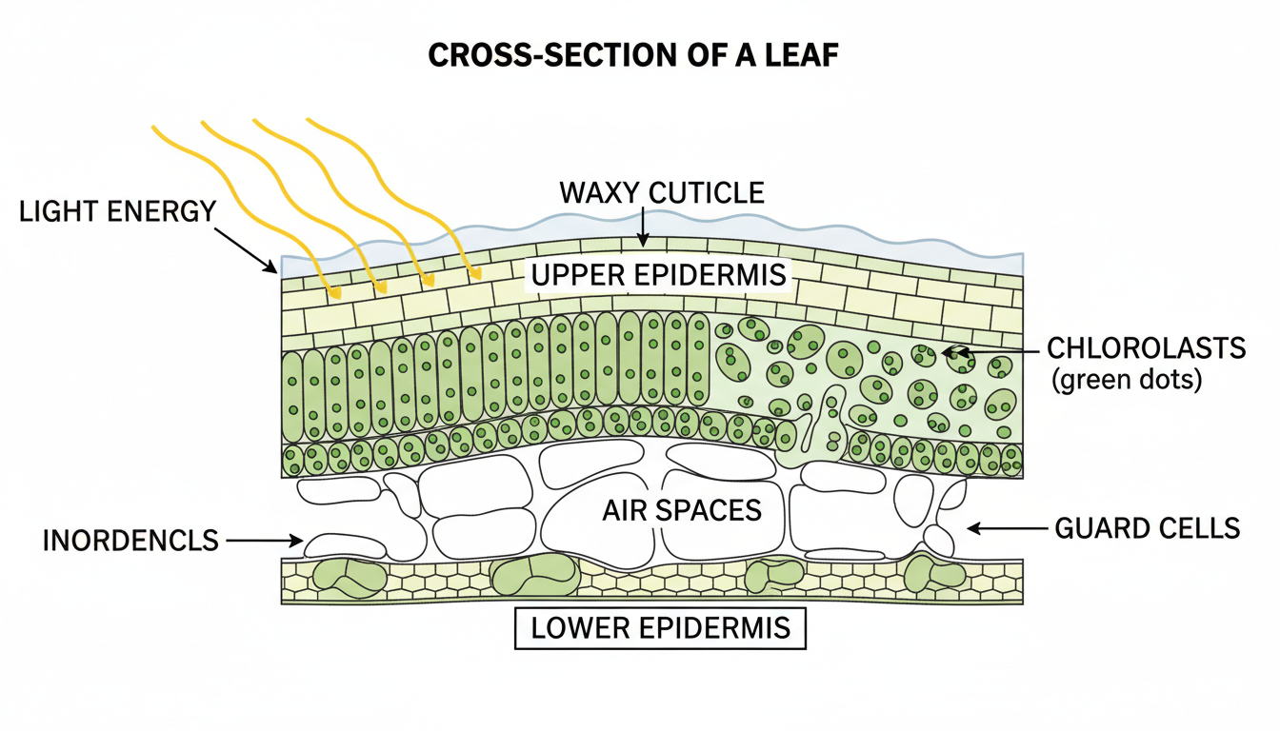
Autotrophic Nutrition: Photosynthesis
Green plants are autotrophs that fulfill their carbon and energy requirements through photosynthesis. They convert carbon dioxide and water into carbohydrates in the presence of sunlight and chlorophyll.
**The Equation:** 6CO₂ + 12H₂O →(Sunlight/Chlorophyll)→ C₆H₁₂O₆ + 6O₂ + 6H₂O
**Key Events:** Absorption of light energy by chlorophyll, splitting of water molecules into hydrogen and oxygen, and reduction of CO₂ to carbohydrates.
**Stomata:** Tiny pores on the leaf surface used for massive gaseous exchange. Guard cells regulate their opening and closing.
**Storage:** Unused carbohydrates are stored as **starch** in plants.
Vedantu - Smart Learning Solution

Slide 4
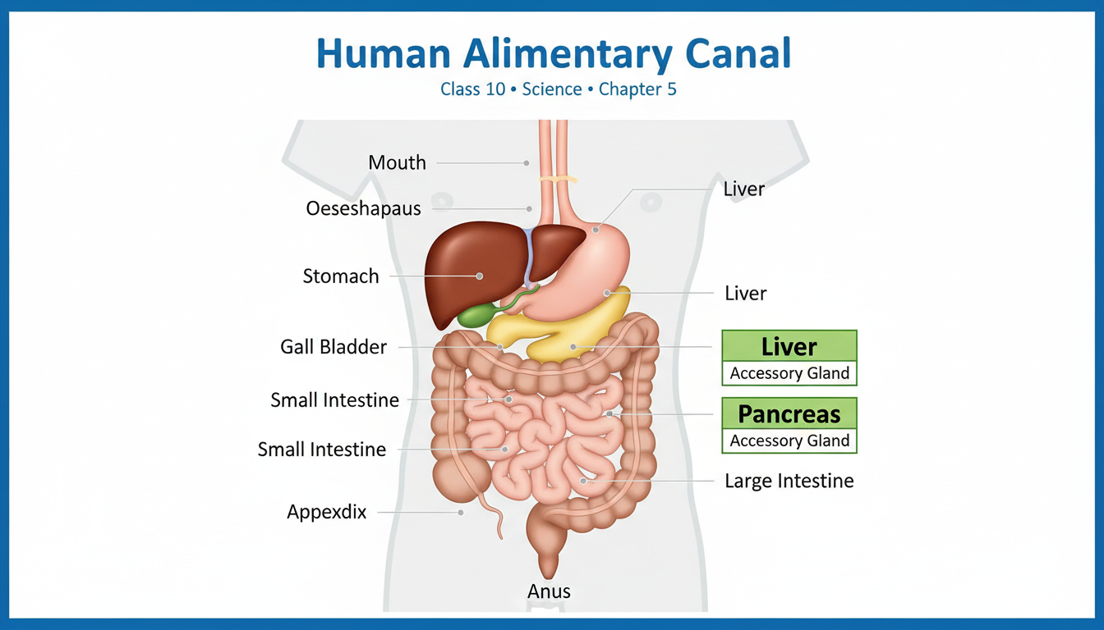
Nutrition in Human Beings
Humans have a specialized alimentary canal for holozoic nutrition. Food is broken down into simpler molecules using biological catalysts called enzymes.
**Mouth:** Salivary amylase breaks down starch into simple sugar.
**Stomach:** Gastric glands release HCl (creates acidic medium), Pepsin (digests protein), and Mucus (protects lining).
**Small Intestine:** The site of complete digestion. Receives bile from the liver (emulsifies fats) and pancreatic juice (Trypsin for proteins, Lipase for fats).
**Absorption:** Villi in the small intestine increase surface area for absorption.
Vedantu - Smart Learning Solution

Slide 5
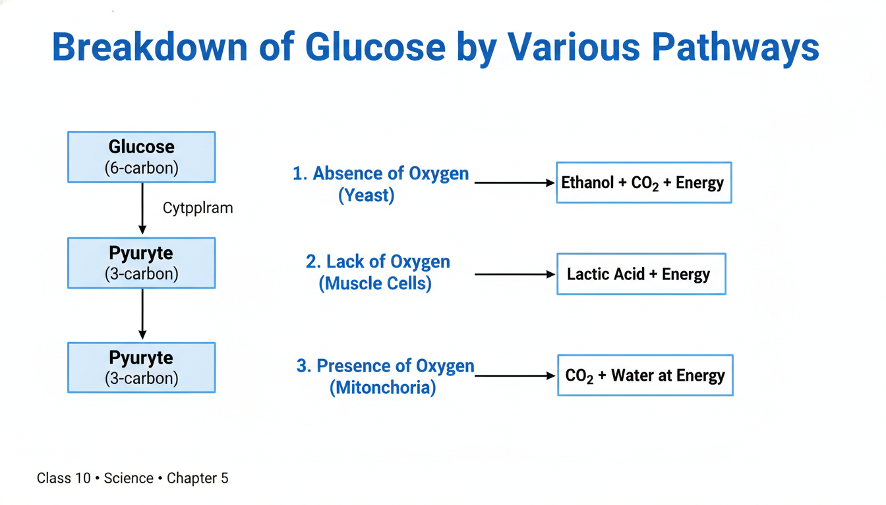
Respiration: Breaking Down Glucose
Respiration involves breaking down food sources (glucose) to release energy for cellular needs. The energy currency produced is ATP (Adenosine Triphosphate).
**Step 1:** Breakdown of Glucose (6-carbon) into Pyruvate (3-carbon) in the Cytoplasm.
**Aerobic Respiration:** Occurs in Mitochondria (presence of oxygen). Products: CO₂, Water, and lots of Energy.
**Anaerobic Respiration:** Occurs in Yeast (fermentation). Products: Ethanol and CO₂.
**Muscle Cramps:** Caused by the build-up of Lactic Acid when there is a lack of oxygen during sudden activity.
Vedantu - Smart Learning Solution

Slide 6
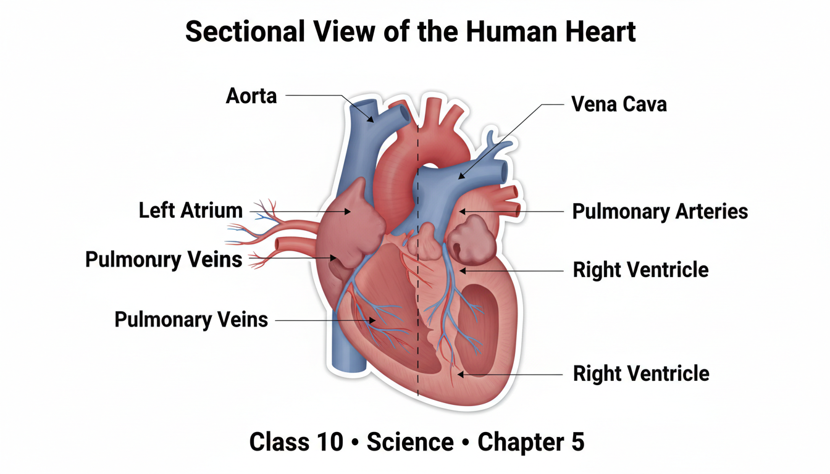
Transportation: The Human Heart
The heart is a muscular pump that separates oxygenated and deoxygenated blood, essential for efficient oxygen supply in mammals and birds.
**Double Circulation:** Blood goes through the heart twice during each cycle.
**Left Side:** Left Atrium receives oxygen-rich blood from lungs; Left Ventricle pumps it to the body (via Aorta).
**Right Side:** Right Atrium receives deoxygenated blood from the body; Right Ventricle pumps it to the lungs.
**Vessels:** Arteries carry blood away from the heart (thick walls); Veins bring blood back (have valves); Capillaries allow exchange of materials.
Vedantu - Smart Learning Solution

Slide 7
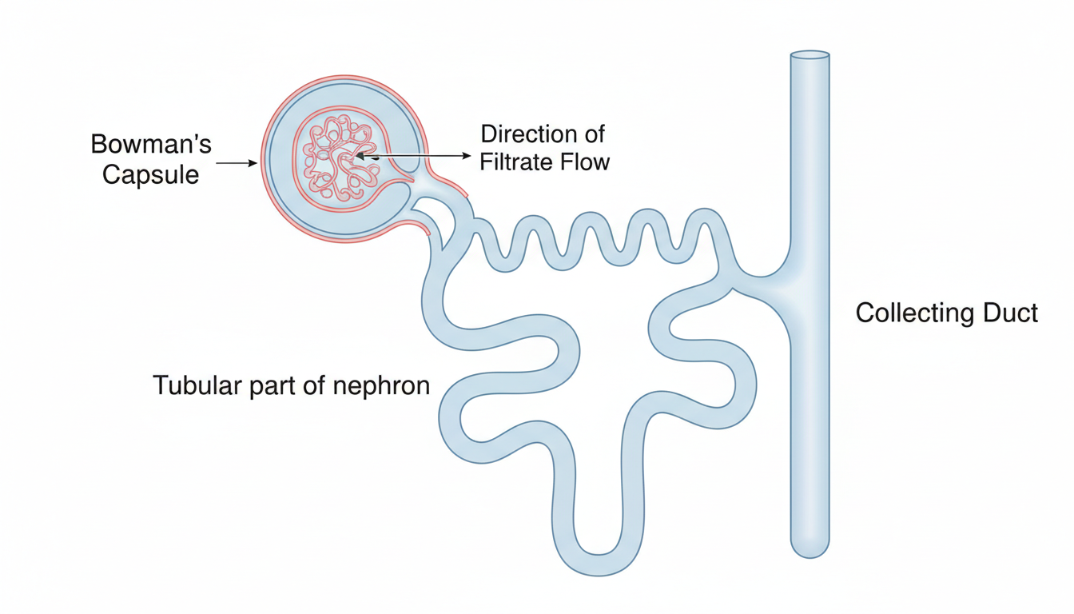
Excretion in Humans
Excretion is the removal of harmful metabolic wastes (like nitrogenous waste) from the body. The kidney is the primary organ for this function.
**System:** Pair of kidneys, ureters, urinary bladder, and urethra.
**Nephron:** The filtration unit of the kidney. It filters blood and selectively reabsorbs glucose, amino acids, salts, and water.
**Urine Formation:** Nitrogenous waste (urea/uric acid) and excess water form urine, which is stored in the bladder.
**Plants:** Excrete waste via transpiration, falling leaves, or storing gums/resins in old xylem.
Vedantu - Smart Learning Solution

Slide 8
QUIZ: Quiz Time!
Which of the following events does NOT occur during photosynthesis?
A) Absorption of light energy by chlorophyll
B) Conversion of carbon to carbon dioxide
C) Reduction of carbon dioxide to carbohydrates
D) Splitting of water molecules
Vedantu - Smart Learning Solution

Slide 9
QUIZ: Quiz Time!
The breakdown of pyruvate to give carbon dioxide, water, and energy takes place in:
A) Cytoplasm
B) Mitochondria
C) Chloroplast
D) Nucleus
Vedantu - Smart Learning Solution

Slide 10
QUIZ: Quiz Time!
In which part of the alimentary canal is food finally and completely digested?
A) Stomach
B) Mouth
C) Large Intestine
D) Small Intestine
Vedantu - Smart Learning Solution

Slide 11
QUIZ: Quiz Time!
The xylem in plants is responsible for:
A) Transport of water
B) Transport of food
C) Transport of amino acids
D) Transport of oxygen
Vedantu - Smart Learning Solution

Slide 12
QUIZ: Quiz Time!
The filtration units of the kidney are called:
A) Ureters
B) Nephrons
C) Neurons
D) Alveoli
Vedantu - Smart Learning Solution

